Slide 1
Software Project Lab - 1
Md. Khairul Alam
BSSE1118

Slide 2
Computerized Adaptive Test
Supervised by,
Dr. Zerina Begum

Slide 3

Computerized Adaptive Test

Slide 4





Computerized Adaptive Test
Project Outline
Objectives
Definition
Description
User Manual
Scope

Slide 5

Computerized Adaptive Test
Objectives
Hi, I am Rahat
Definition
Description
User Manual
Scope
Figure: He is Rahat

Slide 6

Computerized Adaptive Test
Objectives
Definition
Description
User Manual
Scope
Figure: Rahat giving exam

Slide 7


Computerized Adaptive Test
Objectives
Definition
Description
User Manual
Scope
Figure: Rahat being depressed

Slide 8

Computerized Adaptive Test
Objectives
I made CAT system for you
Definition
Description
User Manual
Scope
Figure: Cat Angel was giving Rahat a CAT System Project

Slide 9

Computerized Adaptive Test
Objectives
Yeah. Now, I am giving more correct answers.
Definition
Description
User Manual
Scope
Figure: Now, Rahat is more happy and gain confidence.

Slide 10
Computerized Adaptive Test
Objectives
One kind of Computer Administered Test
Definition
Adapts to the examinee’s ability
Description
Next item is selected by examinee’s responses
User Manual
Scope
Uses: Graduate Management Admission Test, Public Accountant Exam

Slide 11
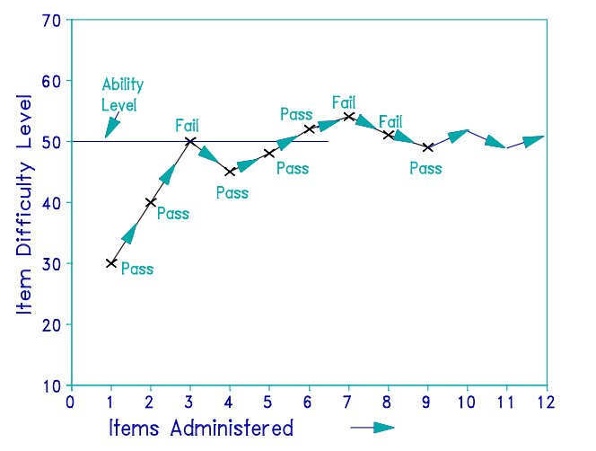
Computerized Adaptive Test
How it works?
Objectives
Definition
Description
User Manual
Scope
Figure: Simple visualization of CAT system

Slide 12
Computerized Adaptive Test
Rasch
Objectives
Definition
Item parameter
Description
Measure estimation
User Manual
Evaluate Ability
Scope

Slide 13
Computerized Adaptive Test
Monte Carlo
Objectives
Definition
Select random sampling
Description
Deterministic Computation
User Manual
Find result
Scope

Slide 14
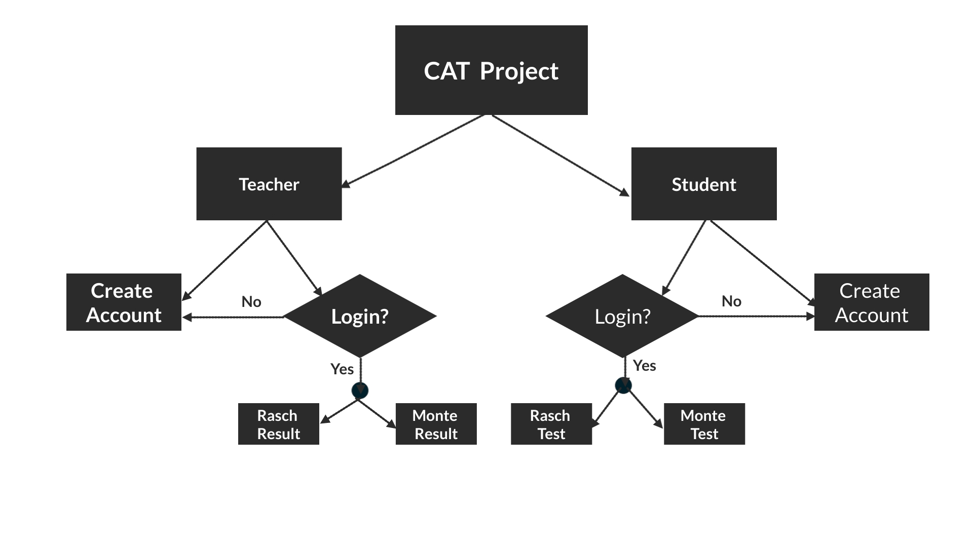
Computerized Adaptive Test
Objectives
Definition
Description
User Manual
Scope
Figure: User Manual Graph

Slide 15
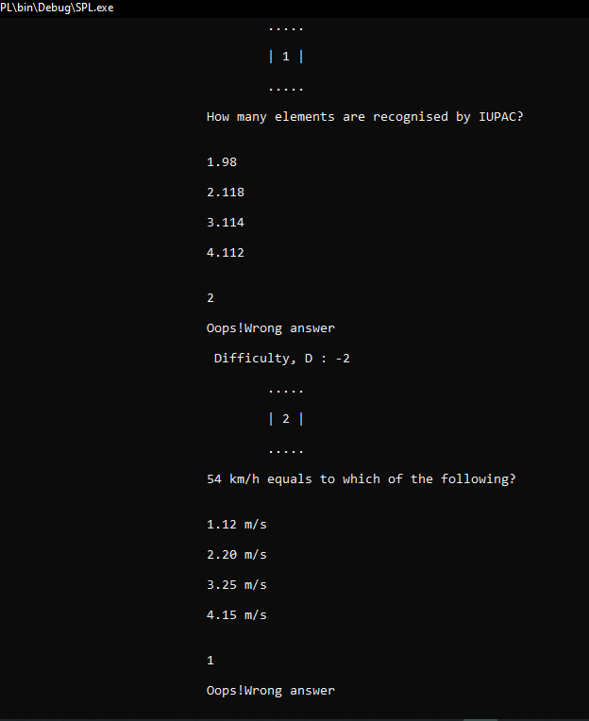
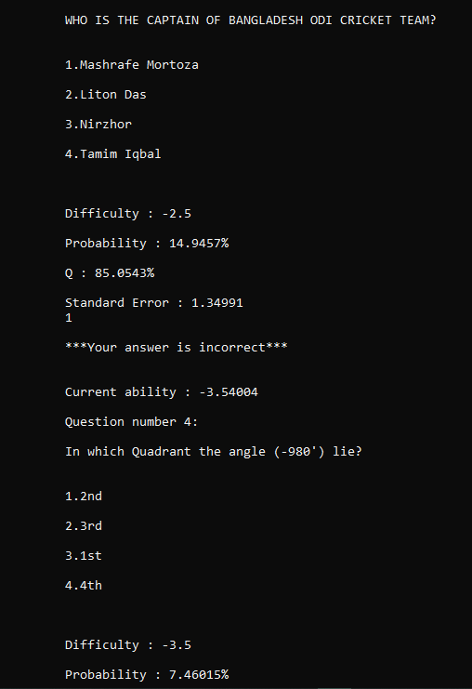
Computerized Adaptive Test
Objectives
Definition
Description
User Manual
Scope
Figure: RaschTest
Figure: Monte Carlo Test

Slide 16
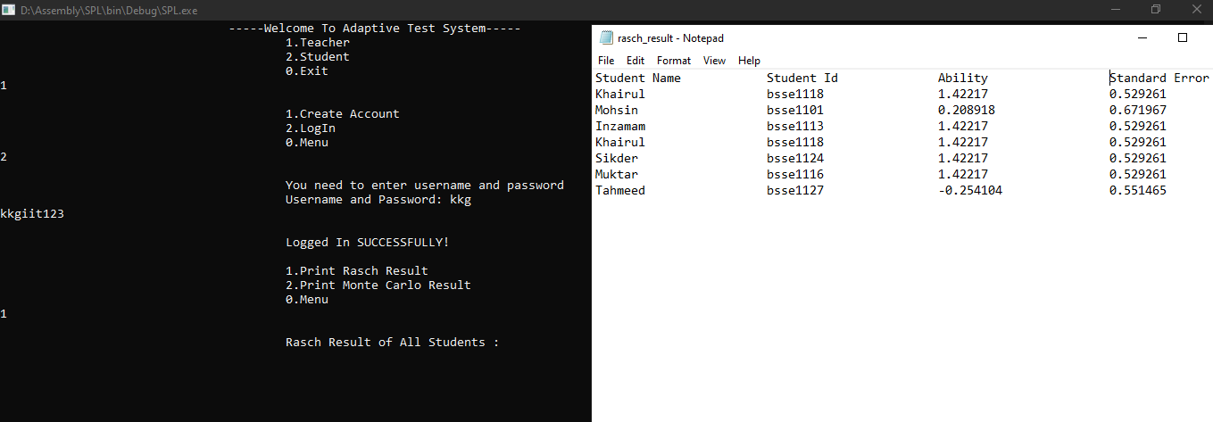
Computerized Adaptive Test
Objectives
Definition
Description
User Manual
Scope
Figure: Teacher showing Rasch result

Slide 17
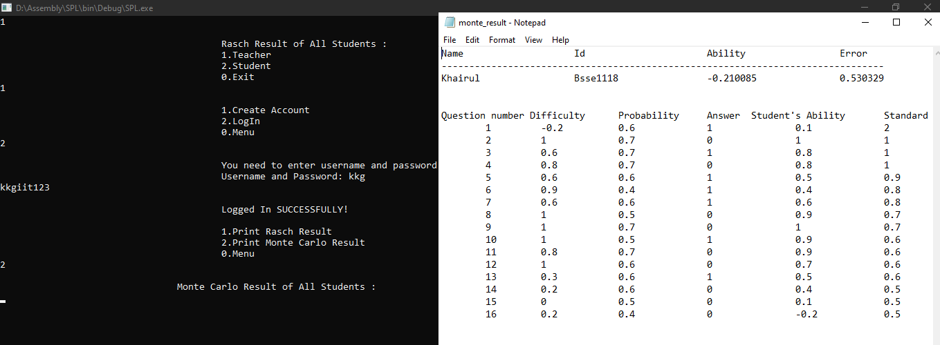
Computerized Adaptive Test
Objectives
Definition
Description
User Manual
Scope
Figure: Teacher showing Monte result

Slide 18
Computerized Adaptive Test
Objectives
Account Manager
Definition
Negative Marking
Description
Skipping Questions
User Manual
Questions and Options Randomly Generated
Scope

Slide 19
Computerized Adaptive Test
Summary
500+ Questions
1000+ line of code
C++
Git link: SPL-1

Slide 20


Slide 21


